Slide 1
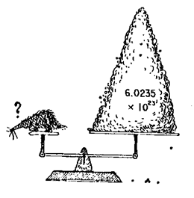
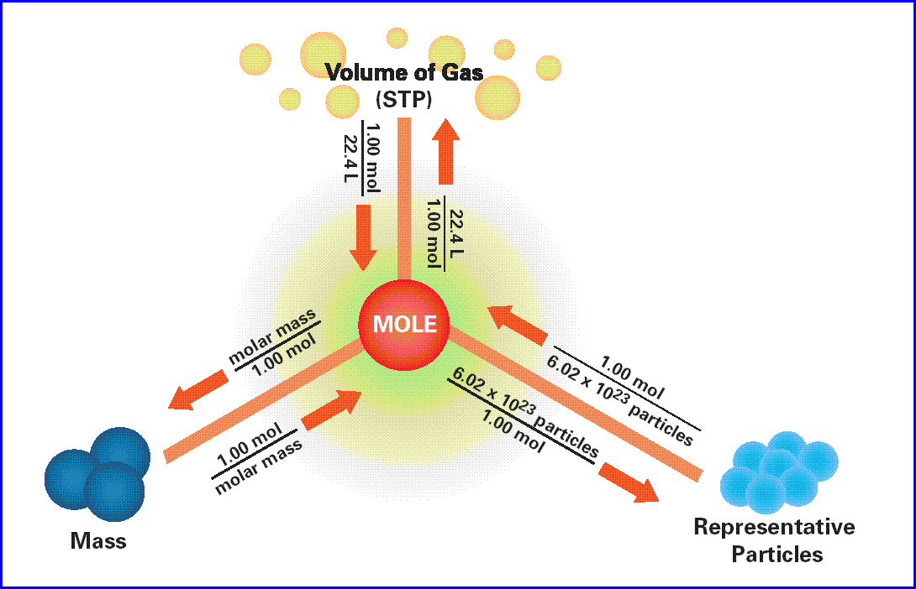
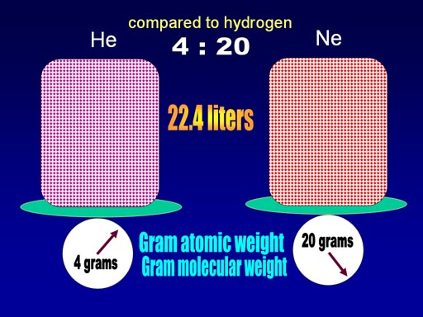
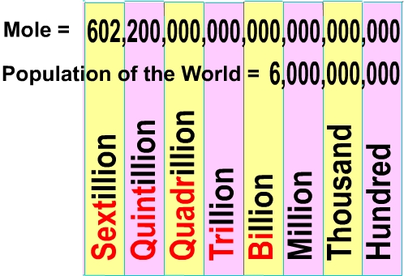
The Mole

Slide 2
Chapter 11: The Mole
____ 11.1 Measuring Matter
____ 11.2 Mass and the Mole
____ 11.3 Moles of Compounds
____ 11.4 Empirical Formulas and Molecular Mass
____ 11.5 The Formula for a Hydrate

Slide 3
11.1 Measuring Matter
Counting Particles
What is a mole (commonly abbreviated mol)
The mole is the SI unit to measure the amount of a substance.
It is the number of representative particles, carbon atoms, in exactly 12g of pure carbon-12.

Slide 4
A mole of anything contains 6.02 X 10²³ representative particles.
A representative particle is any kind of particle such as atoms, molecules, formula units, electrons, or ions.

Slide 5
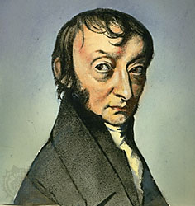
Avagadro’s Number (6.02 X 10²³)
602,000,000,000,000,000,000,000,000
Converting Moles to Particles and Particles to Moles

Slide 7
1. 2.5 mol Zn X
= 1.51 X 10²⁴ atoms Zn
^{2. 3.25 mol AgNO}3 ^{X}
= 1.96 X 10²⁴ formula units AgNO₃
3. 11.5 mol H₂O X
= 6.92 X 10²⁴

Slide 8
Converting Particles to moles: simply multiply the number of particles by the conversion factor.

Slide 9
Ex: Calculate the number of moles that contain 4.5 X 10²⁴ atoms of Zn.

Slide 11
4. a. 9.55 mol Al
b. 6.23 mol CO₃
c. 0.595 mol ZnCl₂
d. 4.15 X 10⁻⁴

Slide 13
Section 11.2 Mass and the Mole
Molar mass
The mass in grams of a mole of any pure substance is called its molar mass.
The molar mass of any element is equal to its atomic mass and has the units g/mol.
Ex. An atom of manganese has the atomic mass of 54.94 amu. Therefore its molar mass is 54.94 g/mol

Slide 14
Mole to Mass Conversion
Ex. What is the mass of 3.00 moles of Mn.
Conversion factor is 1 mole Mn = 54.9g

Slide 16
Answers
11. a. 96.3 g Al
b. 1.2 X 10³ g Si
c. 203 g Co
d. 1.6 X 10² g Zn

Slide 17
Mass to Mole Conversion
Ex. How many moles are there in 525g calcium?

Slide 18
Answers
12. a. 0.236 mol Ag
b. 9.355 mol S
c. 1.91 mol Zn
d. 17.9 mol Fe

Slide 19
Conversions from mass to atoms and atoms to mass (this a two-step process)
Ex. How many atoms are in a 25g sample of pure gold?

Slide 20
Ex. How many atoms are in a 25g sample of pure gold?
Step 1
Multiply the mass of gold by the molar mass conversion factor:

Slide 21
Ex. How many atoms are in a 25g sample of pure gold?
Step 2

Slide 23
Answers
a. 4.79 X 10²⁴ atoms Li
b. 6.68 X 10²⁰ atoms Pb
c. 3.45 X 10²² atoms Hg
d. 9.77 X 10²³ atoms Si
e. 1.51 X 10²⁴ atoms Ti

Slide 24
Note: Mass must always be converted to moles before being converted to atoms, and atoms must first be converted to moles.

Slide 25
Although this is a two step process , you can make this conversion in one step.
Ex. How many molecules are in 1.00 g of H₂O?

Slide 26
Ex. How many molecules are in 1.00 g of H₂O?
You can set up the calculation like this:
The units all cancel to give the answer in molecules of H₂O.

Slide 27
Answers
a. 2.09 X 10³ g Bi
b. 91.3 g Mn
c. 0.226 g He
d. 3.49 X 10⁻⁸ g N
e. 5.93 X 10⁻⁷ g U

Slide 29
The Molar Mass of Compounds
A mole of a compound would contain Avagadro’s number of molecules of that compound.
The mass of a mole of a compound equals the sum of the masses of every particle that makes up the compound.

Slide 30
The Molar Mass of Compounds
Ex. What is the mass of one mole of potassium chromate (K₂CrO₄)?
Use the periodic table to find the molar mass of each element and multiply it by the subscript.
K 39.1g X 2 = 78.2g
Cr 52.0g X 1 = 52.0g
O 16.0g X 4 = 64.0g
Molar mass of K₂CrO₄ = 194.2g

Slide 33
NaOH – 40.00 g
CaCl₂ – 110.98g
KC₂H₃O₂ – 98.14 g
Sr(NO₃) ₂ – 211.64g
(NH₄) ₃PO₄- 149.10g

Slide 34
C₂H₅OH – 46.07g
C₁₂H₂₂O₁₁- 342.30 g
HCN – 27.03 g
CCl₄- 153.81 g
H₂O – 18.02g

Slide 35
Converting Moles of a gas to volume
One mole of any gas at Standard Temperature and Pressure, occupies a volume of 22.4 Liters
STP – Standard Temperature and Pressure (0ºC) (pressure at sea level 101kPa)

Slide 36
Converting Moles of a gas to volume
Ex. What is the volume of 2.5 moles of gas at STP?
2.5 mol X = 61L of Gas
Ex What is the volume of 2g of H₂ gas at STP?
First convert mass to moles.
2gH₂ X 1 mole H₂ X = 22.4L H₂
2 g H₂

Slide 40
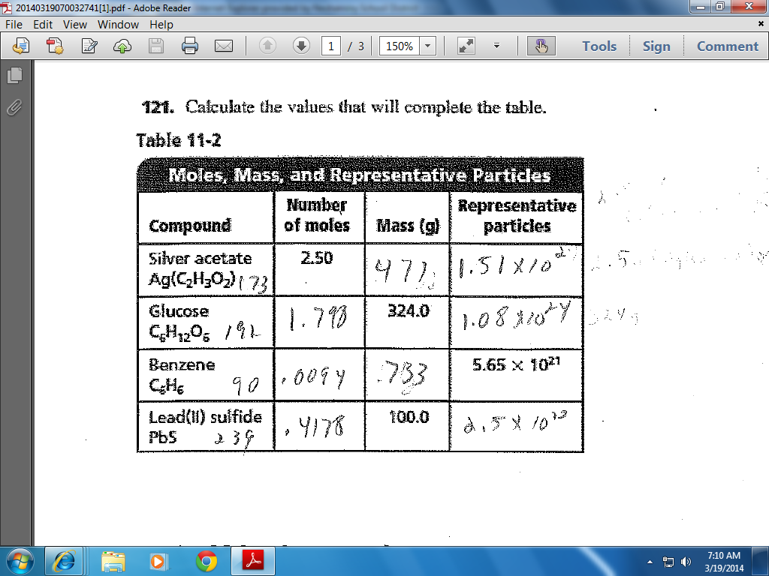

Slide 45
Empirical and Molecular Formulas
Percent Composition from the chemical formula
The percent by mass of all the elements of a compound is called the percent composition of a compound.

Slide 46
Percent Composition from the Chemical Formula
Calculate the mass of each element in a compound and divide this value by the molar mass of the compound
Ex. What is the percent composition of H and O in water H₂O
Mass of H = 2 X 1.01g
Mass of O = 16.00g

Slide 47
Ex. What is the percent composition of H and O in water H₂O

Slide 49
Empirical Formula
The empirical formula for a compound is the smallest whole number ratio of the elements.

Slide 50
Molecular Formula
Molecular Formula specifies the actual number of atoms of each element in one molecule or formula unit of a substance.

Slide 52
42. 36.11% Ca, 63.89%Cl
43. 32.37% Na, 22.58% S, 45.05% O
44. H₂SO₃
45. 3.08% H, 31.61% P, 65.31% O

Slide 53
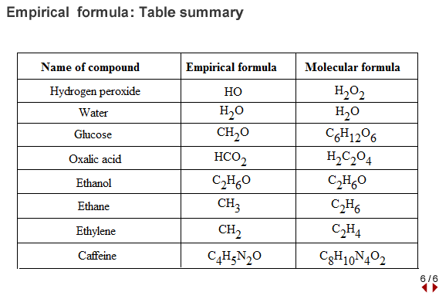
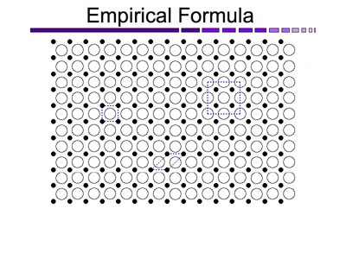
Empirical Formula
The Empirical Formula for a compound is the formula with the smallest whole number mole ratio of the elements.

Slide 54
Calculating Empirical Formula from Percent Composition
This is a three step process:
Step 1: Assume that the total mass of the substance is 100g and express the percent of each element in grams.
Step 2: Convert the mass of each element to moles.
Step 3: Convert the mole ratios to whole numbers by dividing by the smallest mole value.

Slide 55
Ex: The percent composition of a an oxide of sulfur is 40.05% S and 59.95% O, what is the empirical formula?
Step 1: Assume that the total mass of the substance is 100g and express the percent of each element in grams. 40.05g S and 59.95g O
Step 2: Convert the mass of each element to moles.
Step 3: Convert the mole ratios to whole numbers by dividing by the smallest mole value.

Slide 56
Ex: The percent composition of a an oxide of sulfur is 40.5% S and 59.95% O, what is the empirical formula?
Step 1: Assume that the total mass of the substance is 100g and express the percent of each element in grams. 40.5g S and 59.95g O
Step 2: Convert the mass of each element to moles.
Step 3: Convert the mole ratios to whole numbers by dividing by the smallest mole value.
The simplest whole number mole ratio of S atoms to O atoms is 1:3, so the empirical formula is SO₃

Slide 60
46. N₂O₃ 49. C₉H₈O₄
47. Al₂S₃ 50. Mg(ClO₄) ₂
48. C₃H₈

Slide 62
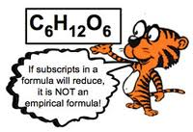

Slide 63
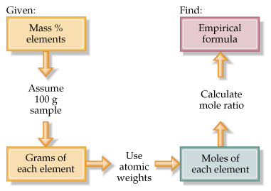

Slide 64
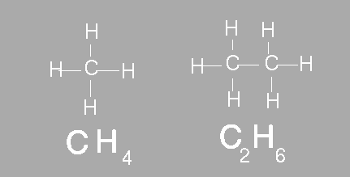
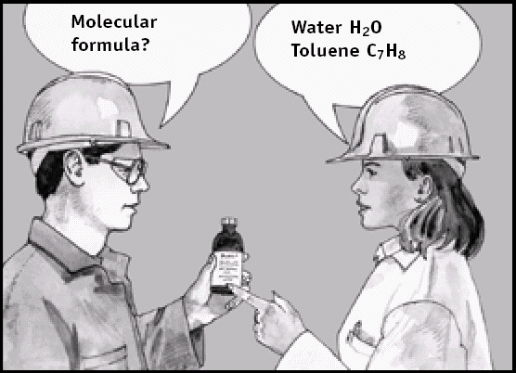

Slide 66
Molecular Formula
The molecular formula specifies the actual number of atoms of each element in one molecule or formula unit of a substance.
EX acetylene,C₂H₂, and benzene C₆H₆, nitrogen dioxide NO₂, and dinitrogen tetroxide, N₂O₄

Slide 67
Molecular Formula
To determine the molecular formula for a compound divide the actual molar mass (usually determined experimentally) by the empirical molar mass.

Slide 68
Molecular Formula
To determine the molecular formula for a compound divide the actual molar mass (usually determined experimentally) of the by the empirical molar mass.
Ex. The molar mass of acetylene is 26.04 g/mol, the mass of the empirical formula CH is 13.20g/mol, what is the molecular formula?
The molar mass of acetylene is 2 times that of the empirical formula so the molecular formula is C₂H₂

Slide 69
So the molecular formula of benzene is C₆H_{6,} the empirical formula is still CH

Slide 71
51. C₆H₆O₂
52. C₄H₁₀
53. N₂O₂

Slide 73
Hydrates
http://www.youtube.com/watch?v=Np_SDsezVXo
http://www.youtube.com/watch?v=HM2C5FEvR0g
http://www.youtube.com/watch?v=pM0LWKQpgvI
http://www.youtube.com/

